Slide 1
A quick Intro to Some Neat Stats
Or not… depends on how you like to spend your Friday nights.

Slide 2
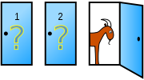
Monty Hall Problem -An exercise in thinking about the sample space
Set up:
You’re on a game show.
There’s a car behind one of 3 Doors and two (loveable) but ultimately unwanted goats behind the other two.
You pick a door.
The host opens another door (one that you didn’t pick and one that didn’t have the car in it).
It reveals a goat (obviously!).
Do you want to keep your original choice or switch doors?
First – let’s think about this analytically and then look at a “Monte Carlo Simulation”
Ooooooooohhhhh, fancy name!

Slide 3
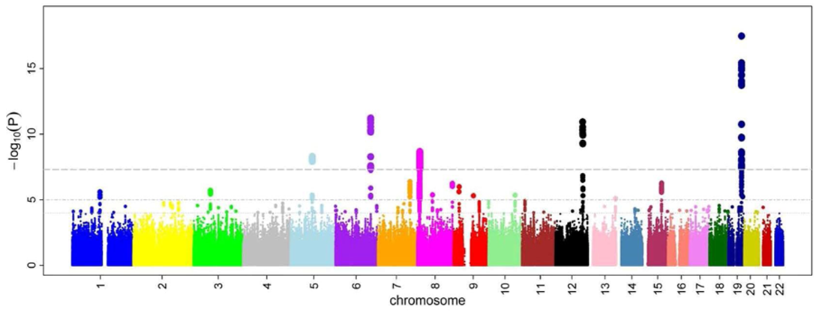
P-values, p-values, p-values! And Maybe a confidence interval or two?
What is the definition of a p-value?
What do you need to get one?
How do you interpret it?
What is the distribution of p-values under the null?
Suppose you run 100 A/B tests. And 5 of the give significant p-values.
Do you get a promotion for saving the company?
What do you tell the PM that is pushing you to take action?
When do you reach for the tequila under your desk?
How do you interpret a confidence interval?
Suppose you go out and collect 100 batteries. 55 of them pass your test.
What is the 95% CI for the proportion of batteries passing?
How do you interpret that CI?

Slide 4
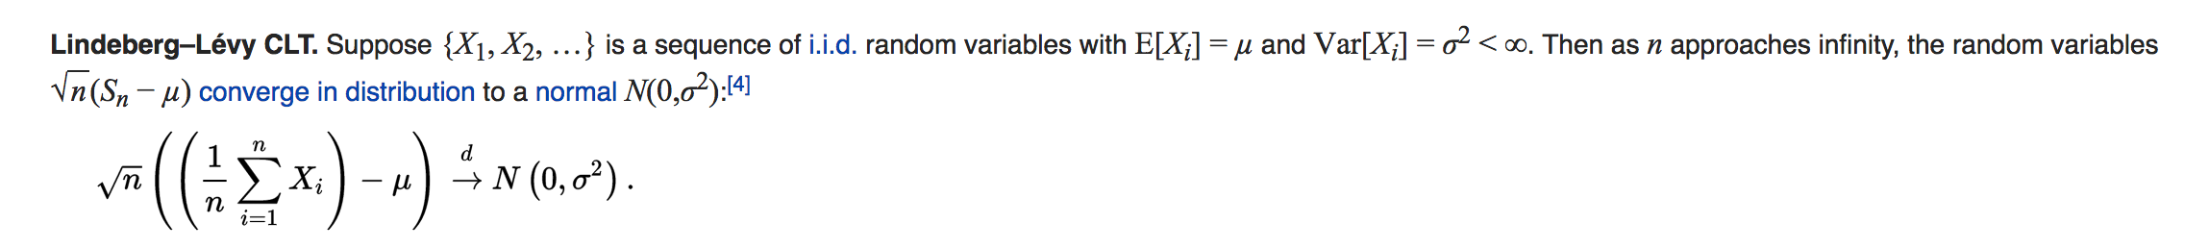

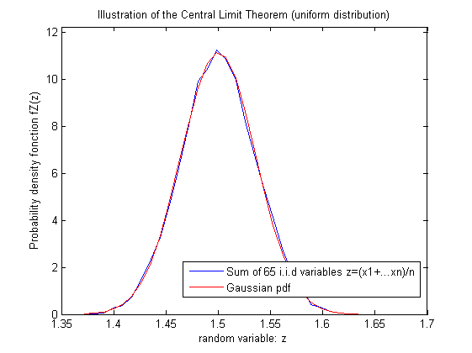
The Central Limit Theorem - And why it’s so awesome.
What does it state?
And why exactly do we care?
Why is it useful?
What does it not state?

